Slide 1
Chapter 4
Signals
Analog and digital
Aperiodic and periodic signals
Analog signals
Digital signals

Slide 2
Analog and Digital
Analog and Digital Data
Analog and Digital Signals
Periodic and Aperiodic Signals

Slide 3

Note:
To be transmitted, data must be transformed to electromagnetic signals.

Slide 4
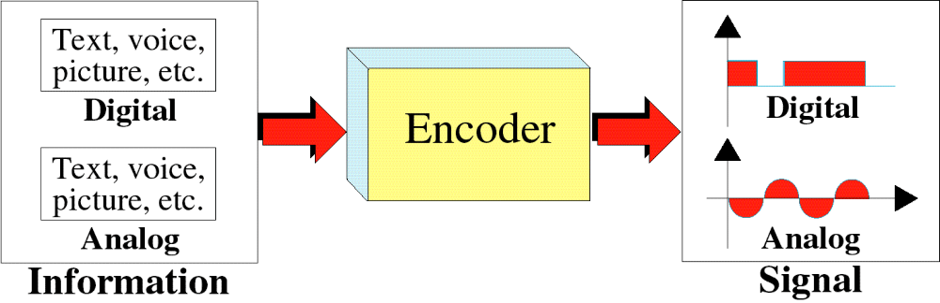
Transformation of Information
to Signals

Slide 5
Note:
Signals can be analog or digital. Analog signals can have an infinite number of values in a range; digital signals can have only a limited number of values.

Slide 6
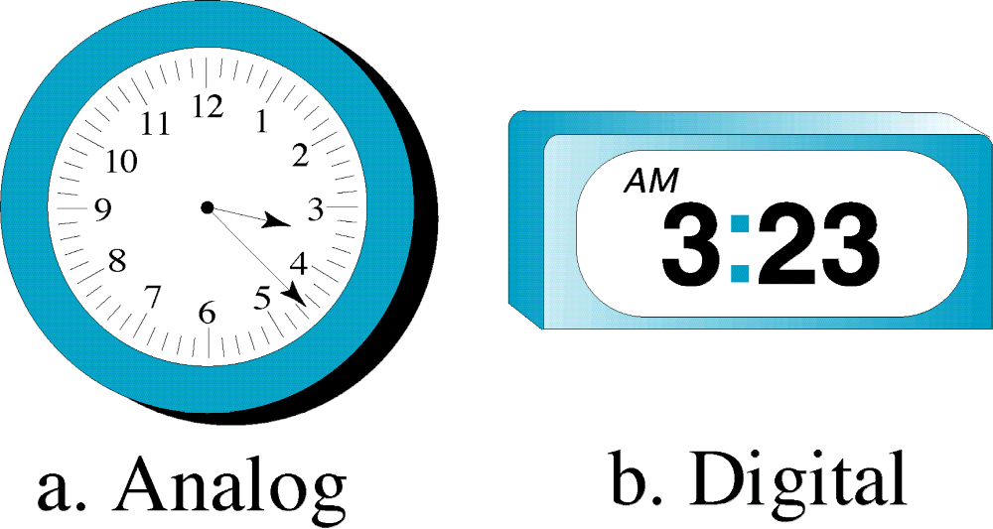
Analog and Digital Clocks

Slide 7
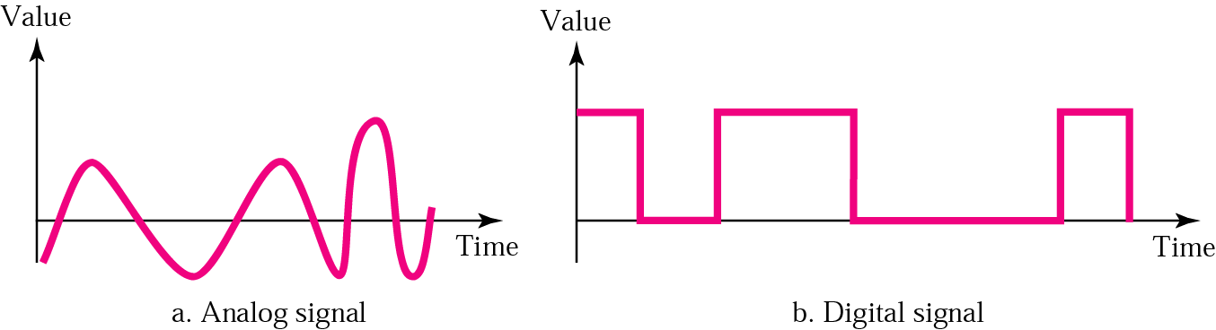
Analog and Digital Signals

Slide 8
Note:
In data communication, we commonly use periodic analog signals and aperiodic digital signals.

Slide 9
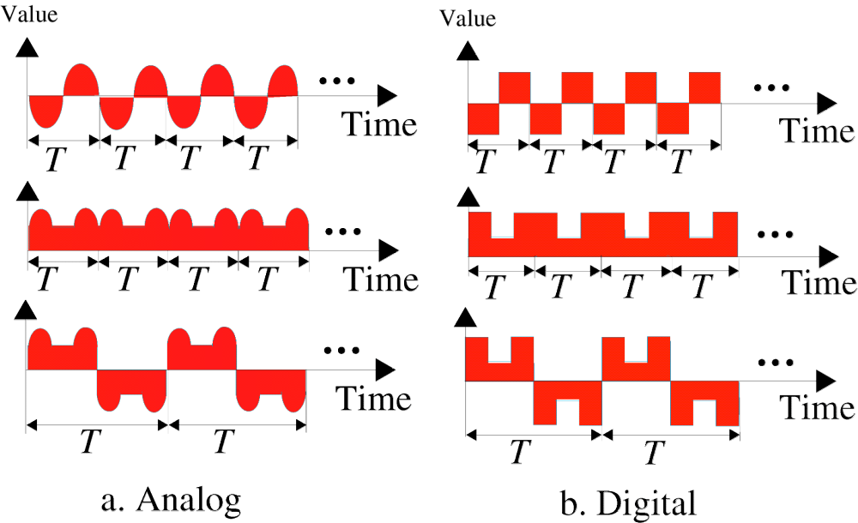
Periodic Signals

Slide 10
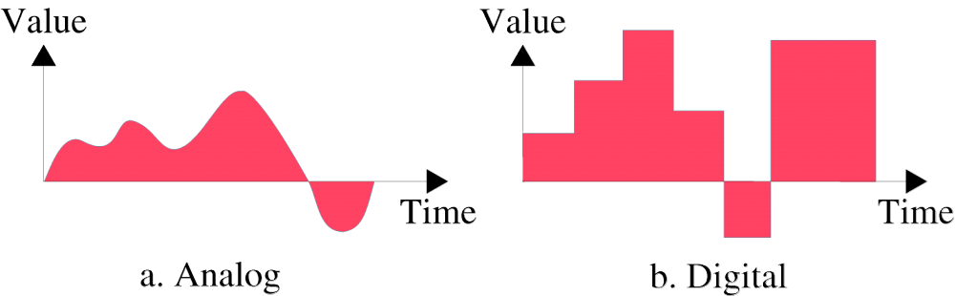
Aperiodic Signals
周期性信号：一个信号能在一段可测量的时间内完成一种模式，并且在随后的周期内不断重复这种模式。
  周期：完成一次循环所需要的时间。
非周期性信号：在随时间不断变化过程中不会出现任何固定的模式和循环。
  傅立叶技术可将非周期信号分解成无数个周期信号的叠加！

Slide 11
Analog Signals
Sine Wave
Phase
Examples of Sine Waves
Time and Frequency Domains
Composite Signals
Bandwidth

Slide 12
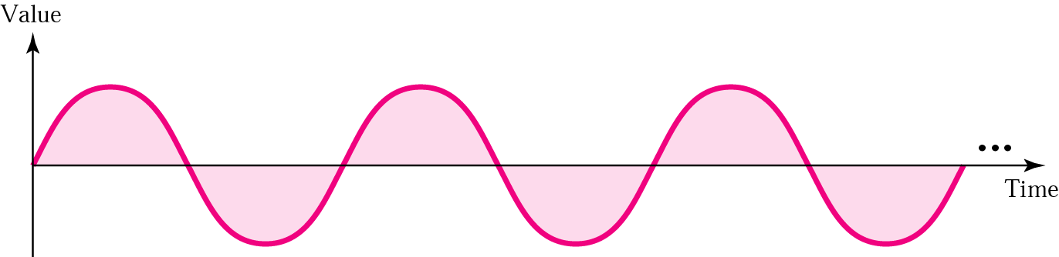
Sine Wave
模拟信号可以被分为简单信号和复合信号。
  简单模拟信号或正弦波：不能被分解为更简单的模拟信号。
  复合信号：可以分解为多个正弦波。
正弦波的三个描述要素：
  振幅、周期或频率、相位

Slide 13
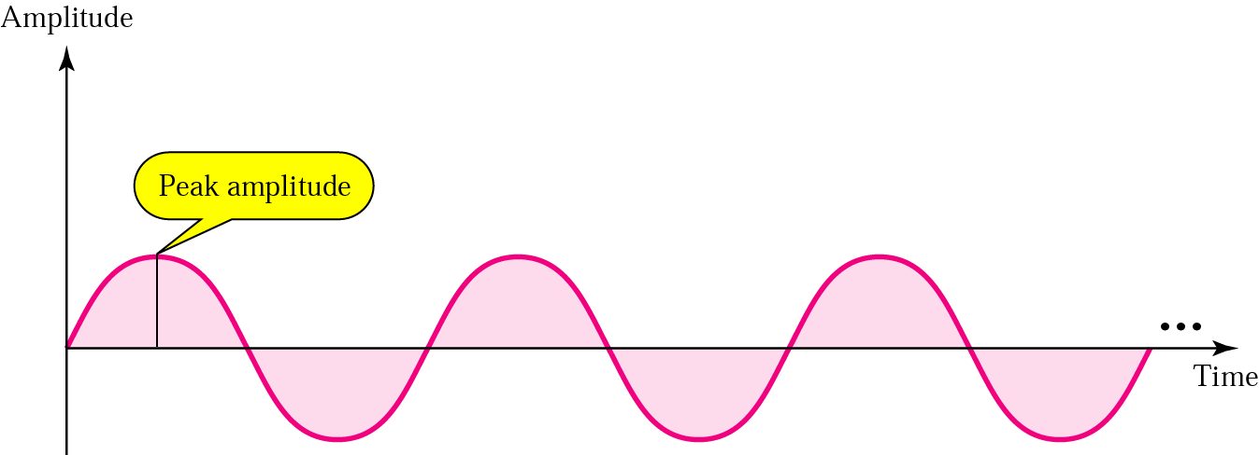
Amplitude
振幅：信号的高度，等于波上给定点到水平轴的垂直距离。
  最大振幅：等于波形在垂直轴上所达到的最大值。

Slide 14
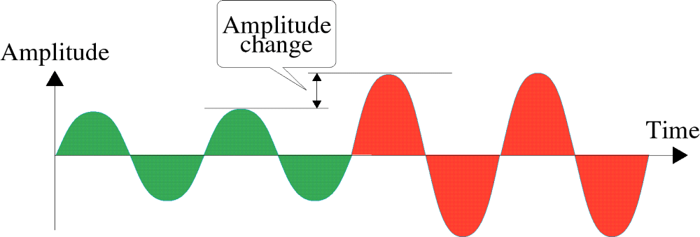
Amplitude Change

Slide 15
Note:
Frequency and period are inverses of each other.

Slide 16
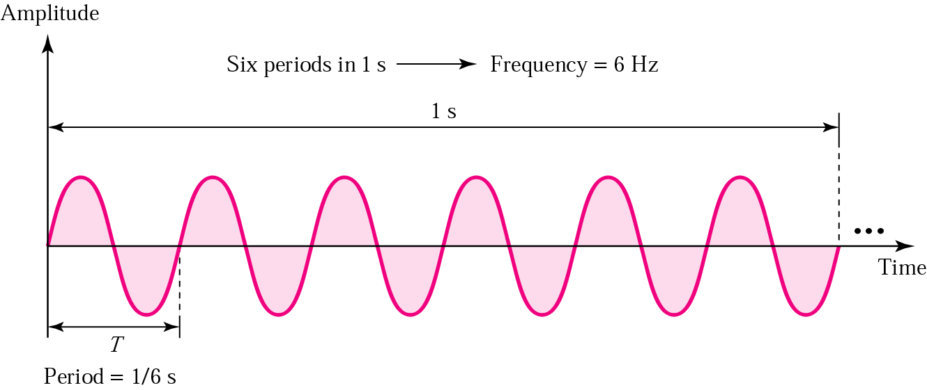
Period and frequency
周期：信号完成一个波形循环所要经历的时间，以秒为单位。
频率：信号在一秒钟内完成的周期数，即每秒钟完成的循环次数。

Slide 17
Period and frequency
Units of periods and frequencies
Unit | Equivalent | Unit | Equivalent
Seconds (s) | 1 s | hertz (Hz) | 1 Hz
Milliseconds (ms) | 10^{–3} s | kilohertz (KHz) | 10³ Hz
Microseconds (ms) | 10^{–6} s | megahertz (MHz) | 10⁶ Hz
Nanoseconds (ns) | 10^{–9} s | gigahertz (GHz) | 10⁹ Hz
Picoseconds (ps) | 10^{–12} s | terahertz (THz) | 10¹² Hz

Slide 18
Example 1
Express a period of 100 ms in microseconds, and express the corresponding frequency in kilohertz.
Solution
From Table 4.1 we find the equivalent of 1 ms.We make the following substitutions:
100 ms = 100 × 10⁻³ s = 100 × 10⁻³ × 10⁶ μs = 10⁵ μs
Now we use the inverse relationship to find the frequency, changing hertz to kilohertz
100 ms = 100 × 10⁻³ s = 10⁻¹ s
f = 1/10⁻¹ Hz = 10 × 10⁻³ KHz = 10⁻² KHz

Slide 19
Note:
Frequency is the rate of change with respect to time. Change in a short span of time means high frequency. Change over a long span of time means low frequency.

Slide 20
Note:
If a signal does not change at all, its frequency is zero. If a signal changes instantaneously, its frequency is infinite.

Slide 21
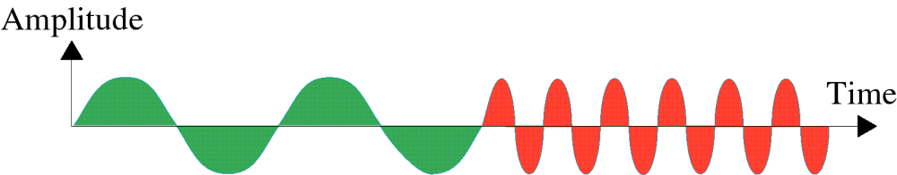
Frequency Change

Slide 22
Note:
Phase describes the position of the waveform relative to time zero.

Slide 23
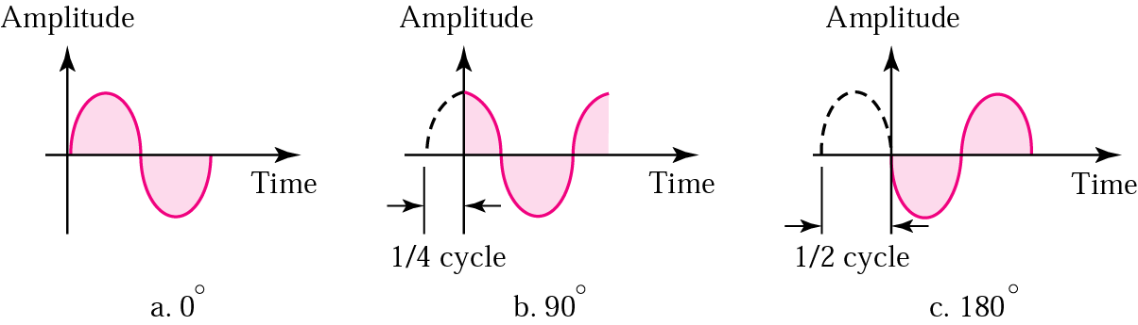
Relationships between different phases
相位：描述了波形中相对于时间零点的位置，以度或弧度为单位。

Slide 24
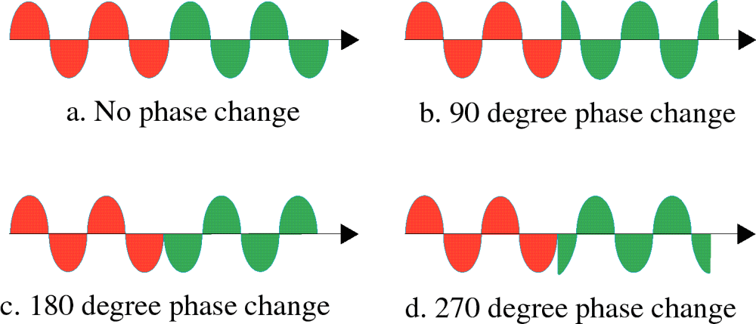
Phase Change

Slide 25
Example 2
A sine wave is offset one-sixth of a cycle with respect to time zero. What is its phase in degrees and radians?
Solution
We know that one complete cycle is 360 degrees.
Therefore, 1/6 cycle is
(1/6) 360 = 60 degrees = 60 x 2π /360 rad = 1.046 rad

Slide 26
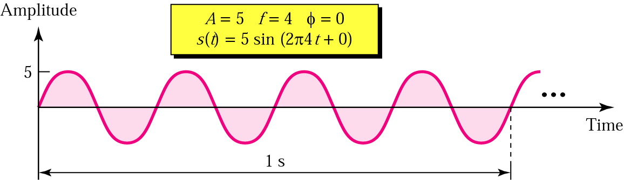
Sine wave examples

Slide 27
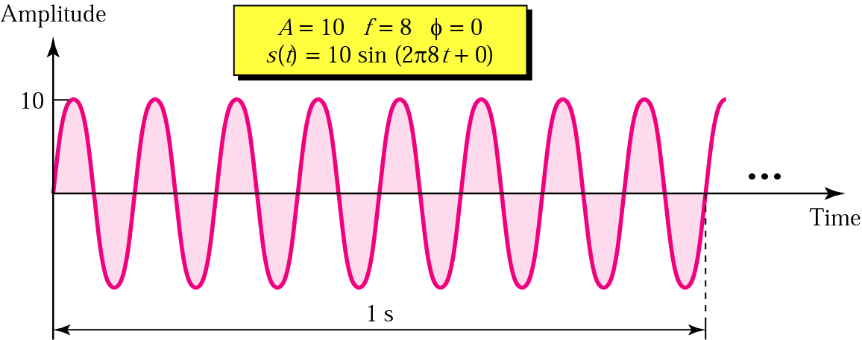
Sine wave examples (continued)

Slide 28
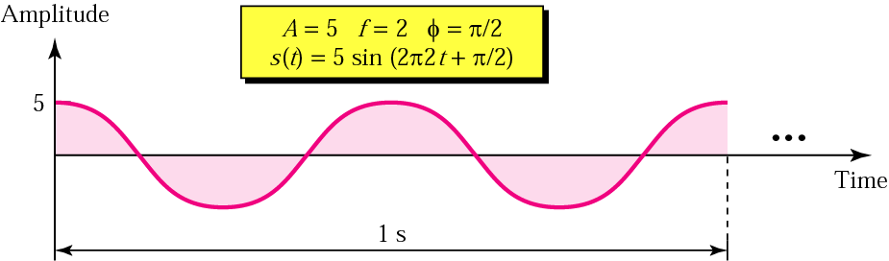
Sine wave examples (continued)

Slide 29
Note:
An analog signal is best represented in the frequency domain.

Slide 30
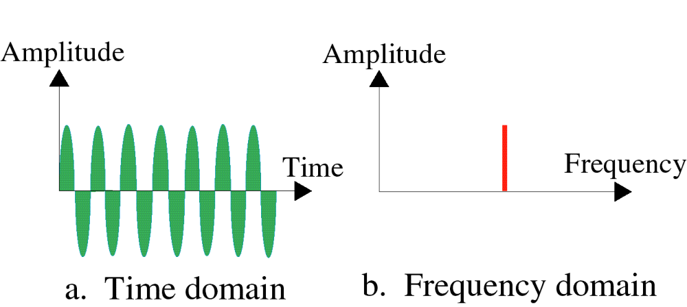
Time and Frequency Domain
时域图：显示了信号振幅随时间的改变。
频域图：可以表现振幅或相位于频率之间的关系。
  最大振幅－频率图（在数据通信中更常用）
  相位－频率图
1 s
12
12
7

Slide 31
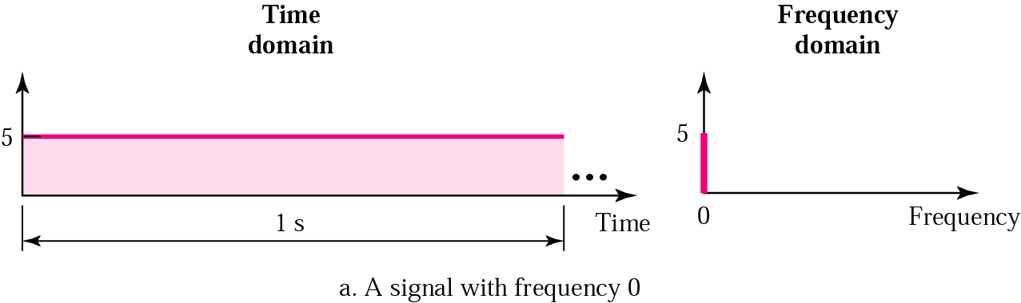
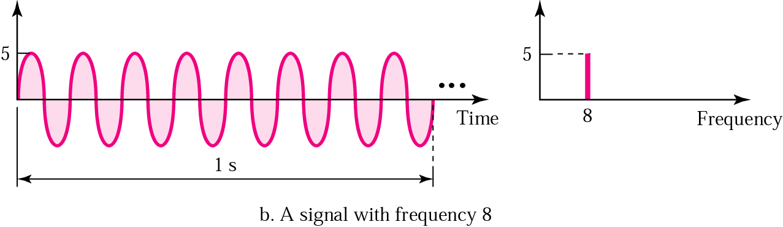
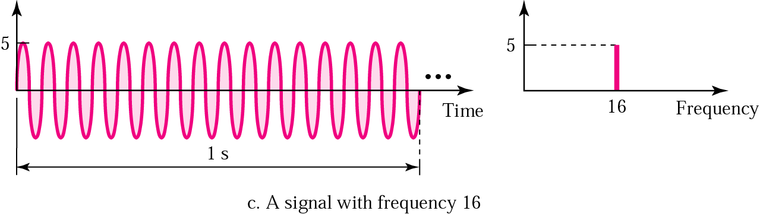

Slide 32
Note:
A single-frequency sine wave is not useful in data communications; we need to change one or more of its characteristics to make it useful.

Slide 33
Note:
When we change one or more characteristics of a single-frequency signal, it becomes a composite signal made of many frequencies.

Slide 34
Note:
According to Fourier analysis, any composite signal can be represented as a combination of simple sine waves with different frequencies, phases, and amplitudes.

Slide 35
Note:
Fourier showed that any composite signal is a sum of a set of sine waves of different frequencies, phases, and amplitudes. In other words, we can write a composite signal as
s(t) = A₁ sin (2πf₁t + φ₁) + A₂ sin (2πf₂t + φ₂) + A₃ sin (2πf₃t + φ₃) + . . .

Slide 36
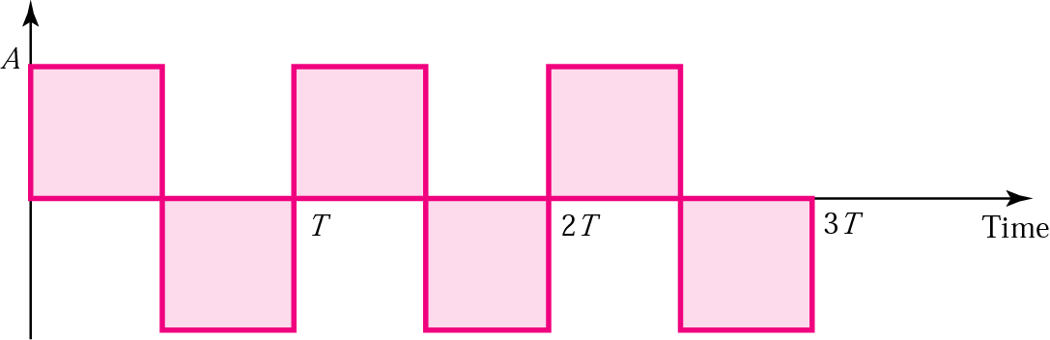
Square wave
  For example, let us consider the square wave with a peak amplitude of A and a frequency of f (period T).
  According to Fourier analysis, we can prove that this signal can be decomposed into a series of sine waves as shown below.
  s(t) = 4A/π sin 2πft + 4A/3π sin [2π(3f )t] + 4A/5π sin [2π(5f )t] + . . .

Slide 37
Square wave
  s(t) = 4A/π sin 2πft + 4A/3π sin [2π(3f )t] + 4A/5π sin [2π(5f )t] + . . .
In other words, we have a series of sine waves with frequencies f, 3f, 5f, 7f, . . . And amplitudes 4A/π, 4A/3π, 4A/5π, 4A/7π, and so on.
  The term with frequency f is dominant and is called the fundamental frequency(基频).
  The term with frequency 3f is called the third harmonic（三次谐波）, the term with frequency 5f is the fifth harmonic（五次谐波）, and so on.

Slide 38
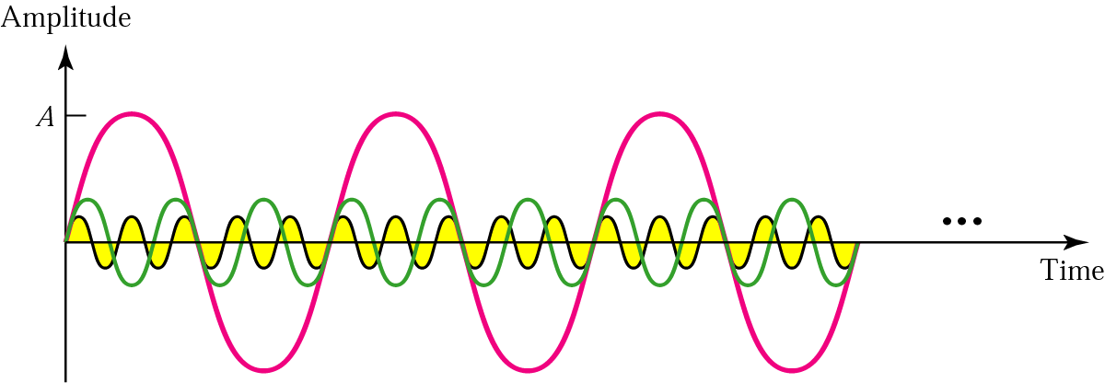
Three harmonics
  To recreate the complete square wave signal requires all the odd harmonics（奇次谐波） up to infinity.
  For example, if the square wave has a frequency of 5000, the components have frequencies 5000, 15,000, 25,000, and so on.

Slide 39
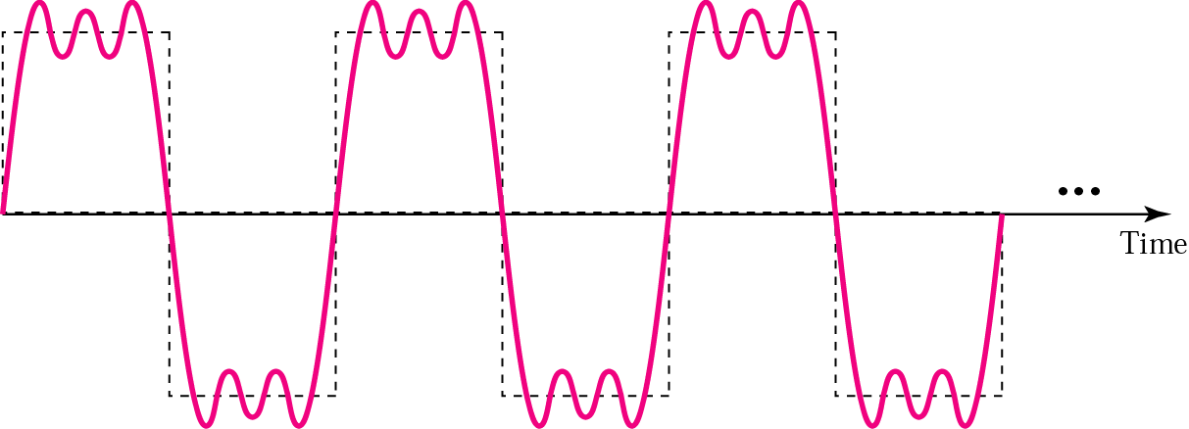
Adding first three harmonics
  Of course, if we add these three harmonics, we do not get a square wave—we get something which is close, but not exact, as shown in following Figure .
  If we need something closer to a square wave, we need to add more harmonics.

Slide 40
Note:
The description of a signal using the frequency domain and containing all its components is called the frequency spectrum(频谱) of that signal.

Slide 41
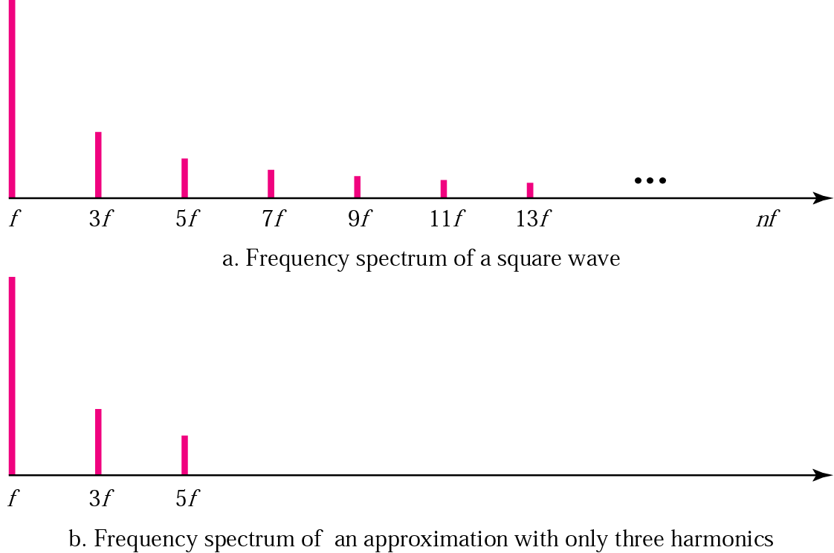
Frequency spectrum comparison

Slide 42
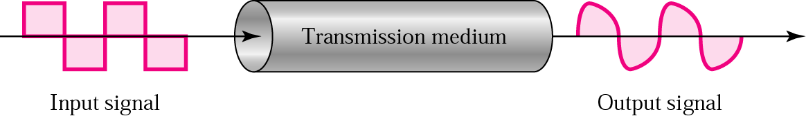
Signal corruption
Since one of the medium’ characteristics is related to frequency, a medium may pass some frequencies and may block or weaken others.
This means that when we send a composite signal, containing many frequencies, at one end of a transmission medium we may not receive the same signal at the other end.

Slide 43
Note:
The bandwidth(带宽) is a property of a medium: It is the difference between the highest and the lowest frequencies that the medium can satisfactorily pass.

Slide 44
Note:
In this book, we use the term bandwidth (带宽) to refer to the property of a medium or the width of a single spectrum.

Slide 45
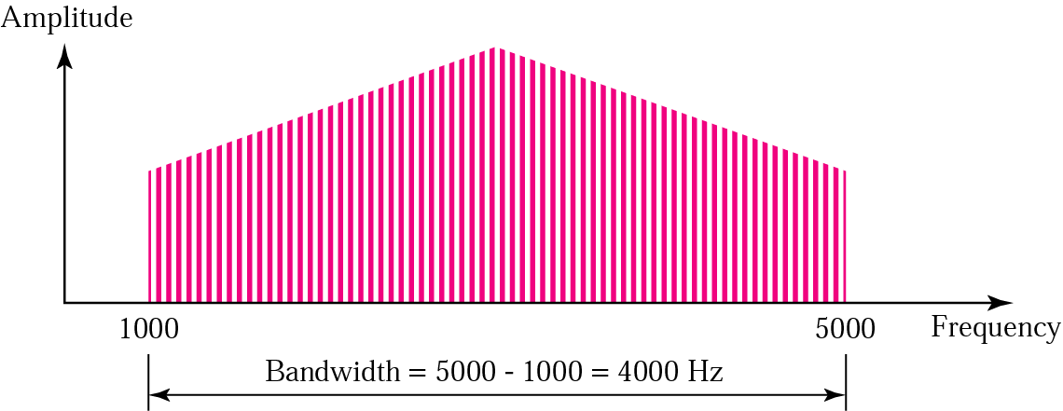
Bandwidth
频谱：信号所包含的所有频率分量的集合，并且通过频域图表示。
带宽：信号频谱的宽度，即信号所包含的频率分量的范围。
频谱指的是带宽内的元素！

Slide 46
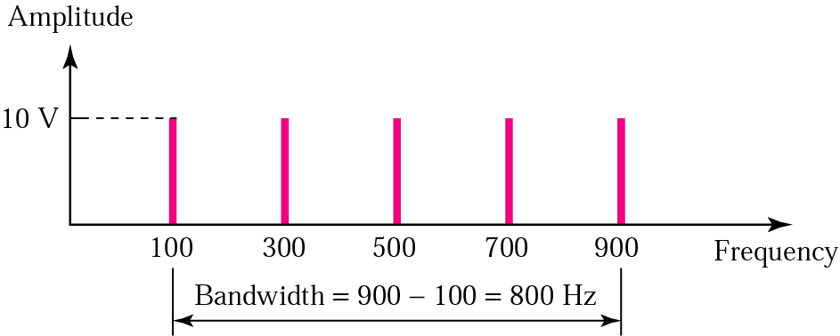
Example 3
If a periodic signal is decomposed into five sine waves with frequencies of 100, 300, 500, 700, and 900 Hz, what is the bandwidth? Draw the spectrum, assuming all components have a maximum amplitude of 10 V.
Solution
B = f_{h} − f_{l} = 900 − 100 = 800 Hz
The spectrum has only five spikes, at 100, 300, 500, 700, and 900 (see the next Figure)

Slide 47
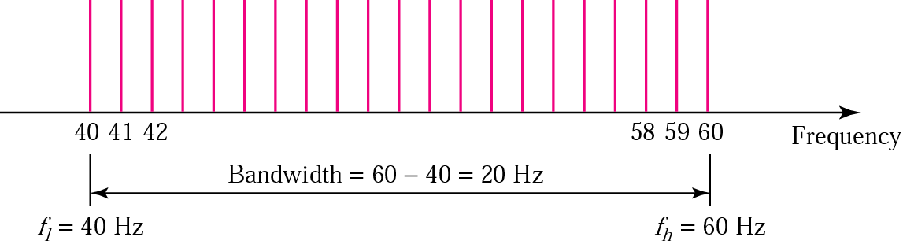
Example 4
A signal has a bandwidth of 20 Hz. The highest frequency is 60 Hz. What is the lowest frequency? Draw the spectrum if the signal contains all integral frequencies of the same amplitude.
Solution
B = f_{h} − f_{l}
20 = 60 − f_{l}
f_{l} = 60 − 20 = 40 Hz

Slide 48
Example 5
A signal has a spectrum with frequencies between 1000 and 2000 Hz (bandwidth of 1000 Hz). A medium can pass frequencies from 3000 to 4000 Hz (a bandwidth of 1000 Hz). Can this signal faithfully pass through this medium?
Solution
The answer is definitely no. Although the signal can have the same bandwidth (1000 Hz), the range does not overlap. The medium can only pass the frequencies between 3000 and 4000 Hz; the signal is totally lost.

Slide 49
Digital Signals
Bit Interval and Bit Rate
As a Composite Analog Signal
Through Wide-Bandwidth Medium
Through Band-Limited Medium
Versus Analog Bandwidth
Higher Bit Rate

Slide 50
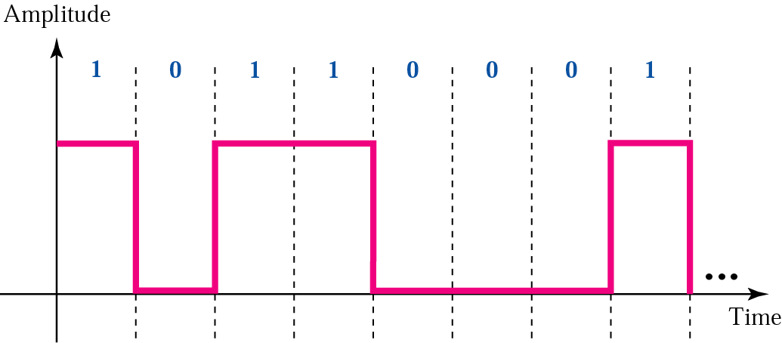
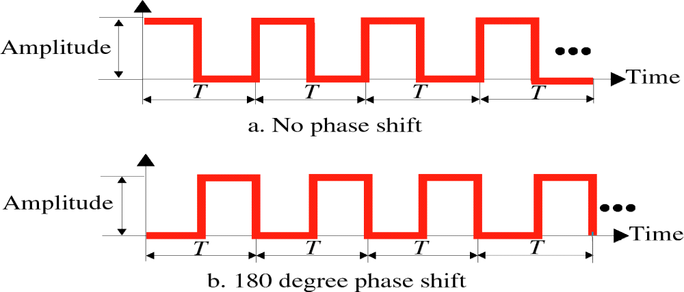
Digital Signal
Amplitude, Period, and Phase for a Digital Signal

Slide 51
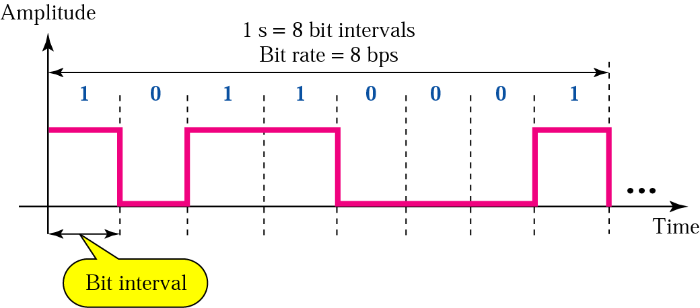
Bit Rate and Bit Interval
比特间隔：发送一比特所需要的时间。
比特率：一秒钟内的比特间隔数，常用bps做单位。

Slide 52
Example 6
A digital signal has a bit rate of 2000 bps. What is the duration of each bit (bit interval)
Solution
The bit interval is the inverse of the bit rate.
Bit interval = 1/ 2000 s = 0.000500 s
= 0.000500 x 10⁶ μs = 500 μs

Slide 53
Note:
A digital signal is a composite signal with an infinite bandwidth.

Slide 54
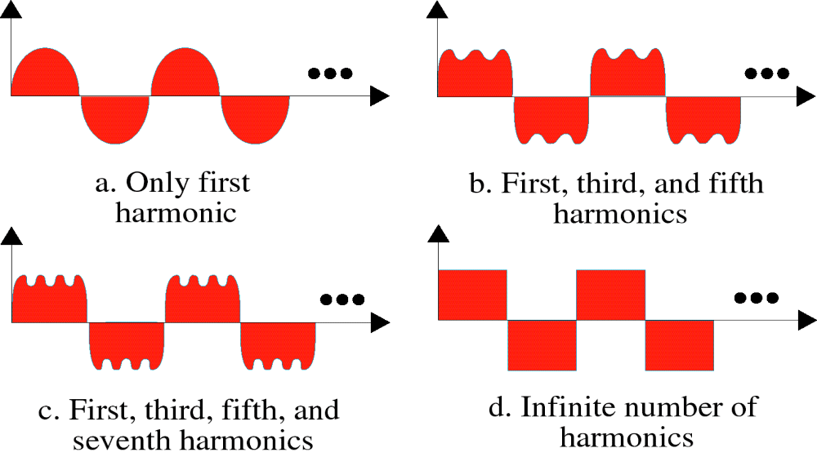
Digital Signal as a Composite Analog Signal
数字信号可以被分解为无穷多个不同的谐波！这意味着我们在传输介质上发送数字信号时，其实是在发送无穷多的简单信号（谐波）。

Slide 55
为了接收到数字信号的精确副本，所有频率的分量都必须通过介质传输；如果部分分量没有通过介质传输过来，就会导致接收端信号的变形。
Bandwidth Requirement
Bit Rate | Harmonic 1 | Harmonics 1, 3 | Harmonics 1, 3, 5 | Harmonics 1, 3, 5, 7
1 Kbps | 500 Hz | 2 KHz | 4.5 KHz | 8 KHz
10 Kbps | 5 KHz | 20 KHz | 45 KHz | 80 KHz
100 Kbps | 50 KHz | 200 KHz | 450 KHz | 800 KHz

Slide 56
Note:
The bit rate and the bandwidth are proportional(成比例的) to each other.

Slide 57
Analog versus Digital
Low-pass versus Band-pass
Digital Transmission
Analog Transmission

Slide 58
Note:
The analog bandwidth of a medium is expressed in hertz; the digital bandwidth, in bits per second.

Slide 59
Digital versus Analog Bandwidth
If we are sending analog data through a medium, we are concerned with analog bandwidth (expressed in hertz); if we are sending digital data through a medium, we are concerned with digital bandwidth (in bits per second).
Analog bandwidth is the range of frequencies that a medium can pass.
Digital bandwidth is the maximum bit rate that a medium can pass.
They represent the same property of a medium, but in different scales and units.

Slide 60
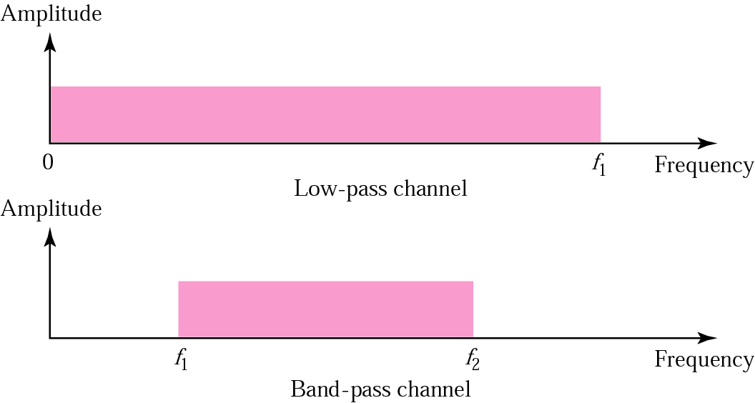
Low-pass and band-pass
A low-pass channel has a bandwidth with frequencies between 0 and f. The lower limit is 0, the upper limit can be any frequency (including infinity).
A band-pass channel has a bandwidth with frequencies between f₁ and f₂.

Slide 61
Note:
Digital transmission needs a
low-pass channel.
A digital signal theoretically needs a bandwidth between 0 and infinity. The lower limit (0) is fixed; the upper limit (infinity) can be relaxed if we lower our standards by accepting a limited number of harmonics.

Slide 62
Note:
Analog transmission can use a band-pass channel.
The bandwidth of an analog signal can always be shifted.
For example, we can always shift a signal with a bandwidth from f₁ to f₂ to a signal with a bandwidth from f₃ to f₄ as long as the width of the bandwidth remains the same.
The bandwidth of a medium can be divided into several band-pass channels to carry several analog transmissions.

Slide 63
Data Rate Limit
Noiseless Channel: Nyquist Bit Rate
Noisy Channel: Shannon Capacity
Using Both Limits

Slide 64
Data Rate Limit
Data rate depends on three factors:
  1. The bandwidth available
  2. The levels of signals we can use
  3. The quality of the channel (the level of the noise).
Two theoretical formulas were developed to calculate the data rate:
  Nyquist for a noiseless channel
  Shannon for a noisy channel

Slide 65
Noiseless Channel: Nyquist Bit Rate
A very simple relationship between the bit rate and bandwidth: to send n bps through an analog channel using the above approximation, we need a bandwidth B such that
B=n/2
For a noiseless channel, the Nyquist bit rate formula defines the theoretical maximum bit rate
BitRate = 2 × Bandwidth × log₂ L
In this formula, Bandwidth is the bandwidth of the channel; L is the number of signal levels used to represent data;and BitRate is the bit rate in bits per second.

Slide 66
Example 7
Consider a noiseless channel with a bandwidth of 3000 Hz transmitting a signal with two signal levels. The maximum bit rate can be calculated as
Solution
Bit Rate = 2 × 3000 × log₂ 2 = 6000 bps

Slide 67
Example 8
Consider the same noiseless channel, transmitting a signal with four signal levels (for each level, we send two bits). The maximum bit rate can be calculated as:
Solution
Bit Rate = 2 x 3000 x log₂ 4 = 12,000 bps

Slide 68
Noisy Channel: Shannon Capacity
Shannon capacity formula determine the theoretical highest data rate for a noisy channel:
Capacity = Bandwidth × log2 (1 + SNR)
In this formula, Bandwidth is the bandwidth of the channel; SNR is the signal-to-noise ratio; and Capacity is the capacity of the channel in bits per second. The signal-to-noise ratio is the statistical ratio of the power of the signal to the power of the noise.
The formula defines a characteristic of the channel, not the method of transmission.

Slide 69
Example 9
Consider an extremely noisy channel in which the value of the signal-to-noise ratio is almost zero. In other words, the noise is so strong that the signal is faint. For this channel the capacity is calculated as
Solution
C = B log₂ (1 + SNR) = B log₂ (1 + 0)
= B log₂ (1) = B × 0 = 0

Slide 70
Example 10
We can calculate the theoretical highest bit rate of a regular telephone line. A telephone line normally has a bandwidth of 3000 Hz (300 Hz to 3300 Hz). The signal-to-noise ratio is usually 3162. For this channel the capacity is calculated as
Solution
C = B log₂ (1 + SNR) = 3000 log₂ (1 + 3162)
= 3000 log₂ (3163)
C = 3000 × 11.62 = 34,860 bps

Slide 71
Example 11
We have a channel with a 1 MHz bandwidth. The SNR for this channel is 63; what is the appropriate bit rate and signal level?
Solution
First, we use the Shannon formula to find our upper limit.
C = B log₂ (1 + SNR) = 10⁶ log₂ (1 + 63) = 10⁶ log₂ (64) = 6 Mbps
Then we use the Nyquist formula to find the
number of signal levels.
4 Mbps = 2 × 1 MHz × log₂ L ➔ L = 4

Slide 72
Transmission Impairment
Attenuation
Distortion
Noise

Slide 73
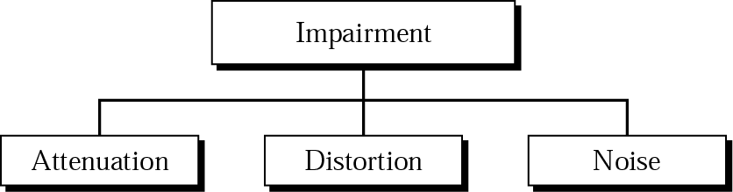
Transmission Impairment
  The transmission media that signals travel through are not perfect, which cause impairment in the signal.
  Three types of impairment usually occur:
  attenuation(衰减)
  distortion(变形)
  noise(噪声)

Slide 74
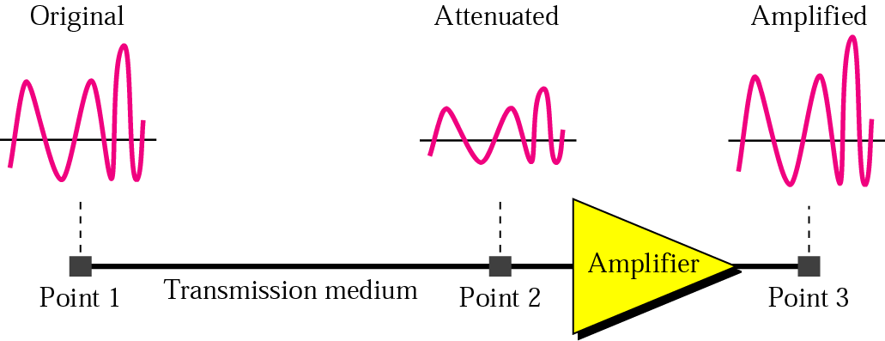
Attenuation
  Attenuation means loss of energy. Because some of the electrical energy in the signal is converted to heat.
  To compensate for this loss, amplifiers are used to amplify the signal.

Slide 75
Decibel
  We can use the concept of the decibel(分贝) to show that a signal has lost or gained strength.
  The decibel (dB) measures the relative strengths of two signals or a signal at two different points.
  Note that the decibel is negative if a signal is attenuated and positive if a signal is amplified.
  dB = 10 log₁₀ (P₂ /P₁)
  Where P₁ and P₂ are the powers of a signal at points 1 and 2, respectively.

Slide 76
Example 12
Imagine a signal travels through a transmission medium and its power is reduced to half. This means that P2 = 1/2 P1. In this case, the attenuation (loss of power) can be calculated as
Solution
10 log₁₀ (P2/P1) = 10 log₁₀ (0.5P1/P1) = 10 log₁₀ (0.5)
= 10(–0.3) = –3 dB

Slide 77
Example 13
Imagine a signal travels through an amplifier and its power is increased ten times. This means that P₂ = 10 × P₁. In this case, the amplification (gain of power) can be calculated as
Solution
10 log₁₀ (P₂/P₁) = 10 log₁₀ (10P₁/P₁)
= 10 log₁₀ (10) = 10 (1) = 10 dB

Slide 78
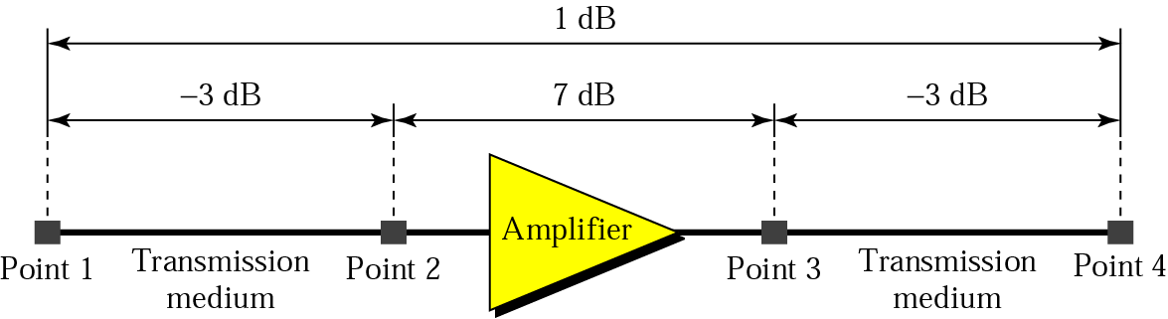
Example 14
One reason that engineers use the decibel to measure the changes in the strength of a signal is that decibel numbers can be added (or subtracted) when we are talking about several points instead of just two (cascading).
In the Figure a signal travels a long distance from point 1 to point 4. The signal is attenuated by the time it reaches point 2. Between points 2 and 3, the signal is amplified. Again, between points 3 and 4, the signal is attenuated. We can find the resultant decibel for the signal just by adding the decibel measurements between each set of points.
dB = –3 + 7 – 3 = +1

Slide 79
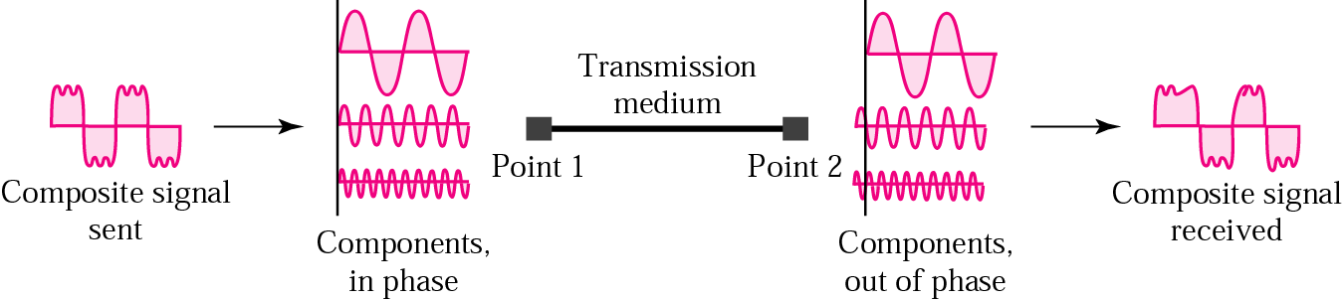
Distortion
Distortion means that the signal changes its form or shape.
Distortion occurs in a composite signal, made of different frequencies. Each signal component has its own propagation speed through a medium and, therefore, its own delay in arriving at the final destination.

Slide 80
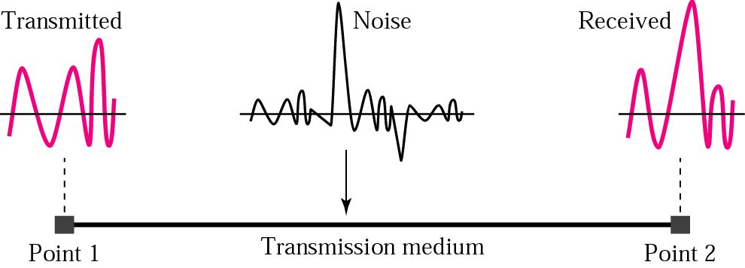
Noise
Several types of noise:
  Thermal noise is the random motion of electrons in a wire which creates an extra signal not originally sent by the transmitter.
  Induced noise comes from sources such as motors and appliances. These devices act as a sending antenna and the transmission medium acts as the receiving antenna.
  Crosstalk is the effect of one wire on the other. One wire acts as a sending antenna and the other as the receiving antenna.
  Impulse noise is a spike (a signal with high energy in a very short period of time) that comes from power lines, lightning, and so on.

Slide 81
More About Signals
Throughput
Propagation Speed
Propagation Time
Wavelength

Slide 82
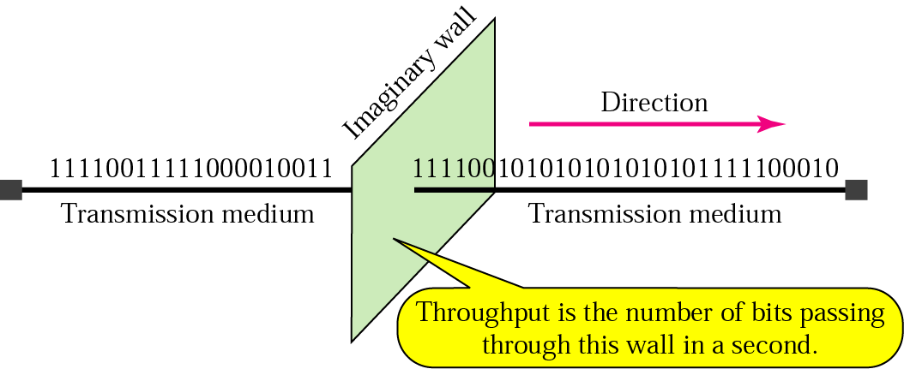
Throughput(吞吐量)
The throughput is the measurement of how fast data can pass through an entity (such as a point or a network).
Throughput is the number of bits that can pass this entity in one second.

Slide 83
Propagation Speed
Propagation speed measures the distance a signal or a bit can travel through a medium in one second.
The propagation speed of electromagnetic signals depends on the medium and on the frequency of the signal.
For example, in a vacuum, light is propagated with a speed of 3 × 108 m/s. It is lower in air. It is much lower in a cable.

Slide 84
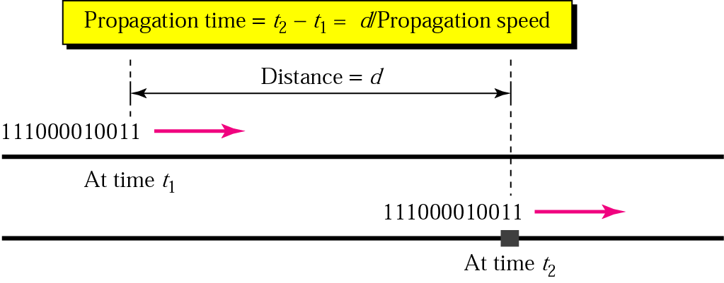
Propagation time(传输时间)
Propagation time measures the time required for a signal (or a bit) to travel from one point of the transmission medium to another.
The propagation time is calculated by dividing the distance by the propagation speed.
Propagation time = Distance/Propagation speed

Slide 85
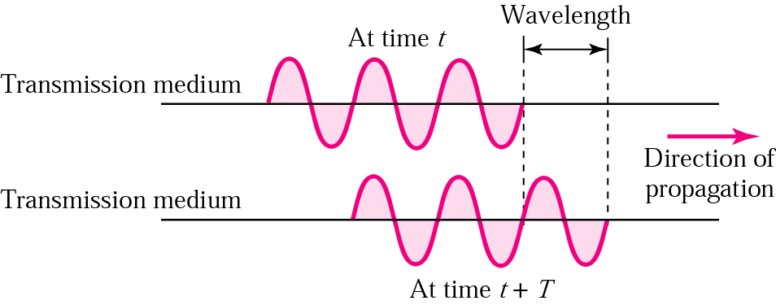
Wavelength
The wavelength is the distance a simple signal can travel in one period.

Slide 86
Wavelength
The wavelength is the distance a simple signal can travel in one period.
  Wavelength binds the period or the frequency of a simple sine wave to the propagation speed of the medium.
  In other words, while the frequency of a signal is independent of the medium, the wavelength depends on both the frequency and the medium.
Although wavelength can be associated with electrical signals, it is customary to use wavelengths when talking about the transmission of light in an optical fiber.

